Slide 1

FINAL PRESENTATION
Breath of the city:
Assessing Air Quality in New York
Prepared by:
ABHISHEK , MUSKAN SHARMA
SELVI PATEL , SHEN ZHANG

Slide 2





MEET OUR TEAM
Abhishek Project leader
Selvi Patel Developer
Muskan Sharma Developer
Shen Zhang Data Analyst

Slide 3
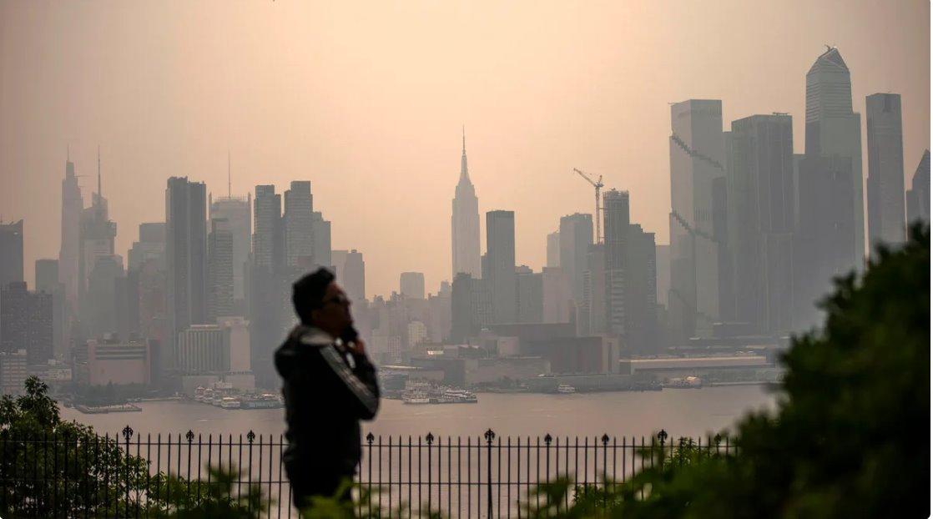
POLLUTANTS THAT WE AIM TO ANALYZE:
Carbon Monoxide (CO): In urban areas, CO levels can be elevated ​due to vehicle emissions and industrial activities. High concentrations of CO can be harmful to human health, particularly for those with heart conditions and can lead to symptoms like headaches and fatigue.​
Ozone (O3): It can cause respiratory problems, aggravate ​asthma, and reduce lung function. Understanding ozone levels ​helps in assessing the effectiveness of pollution control strategies​and in protecting public health.​
Nitrogen Dioxide (NO2): High levels of NO2 can lead to ​respiratory problems, decrease lung function, and increase​the risk of respiratory infections. Monitoring NO2 helps in ​evaluating the impact of transportation and industrial emissions ​on air quality.

Slide 4

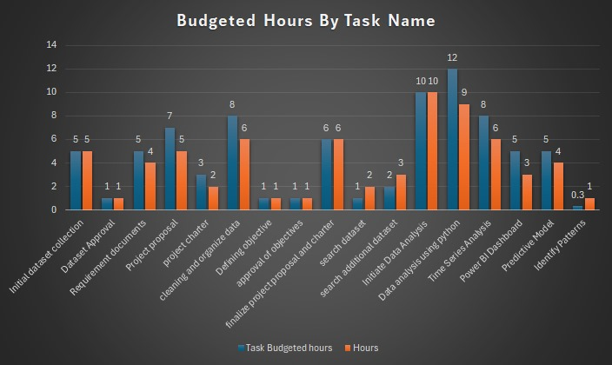
PROJECT BUDGET
Budgeted Hours=80
Rate per Hour- $40
Total Actual Hours x Rate
Budget = $40*69= $2760

Slide 5
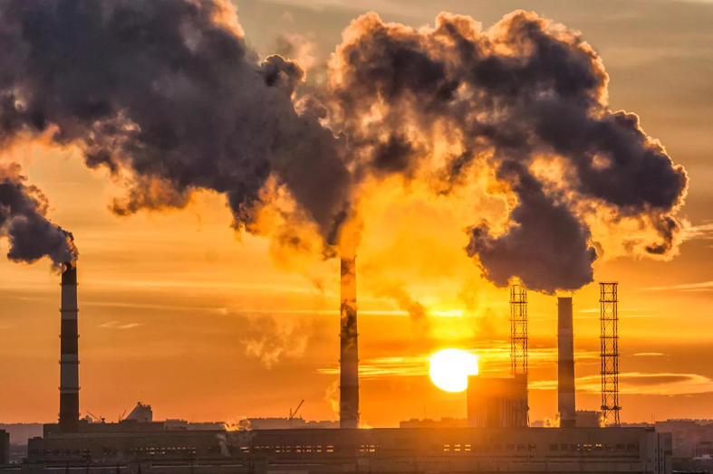
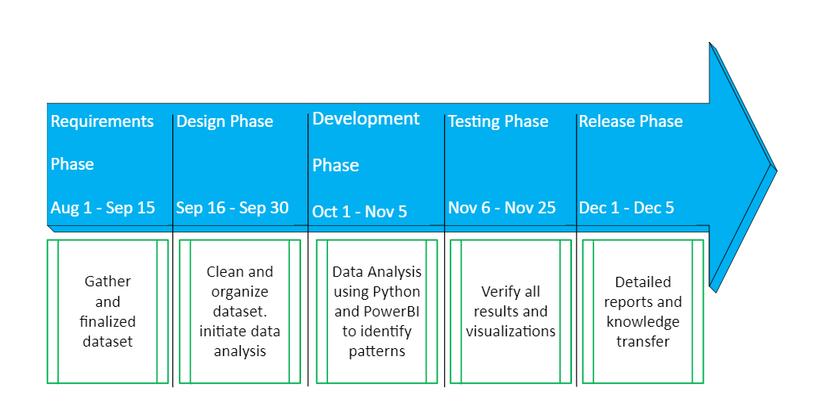
IMPLEMENTATION PLAN:
In-charge:
Abhishek Abhishek
Muskan Sharma
Selvi NileshKumar Patel
Shen Zhang

Slide 6

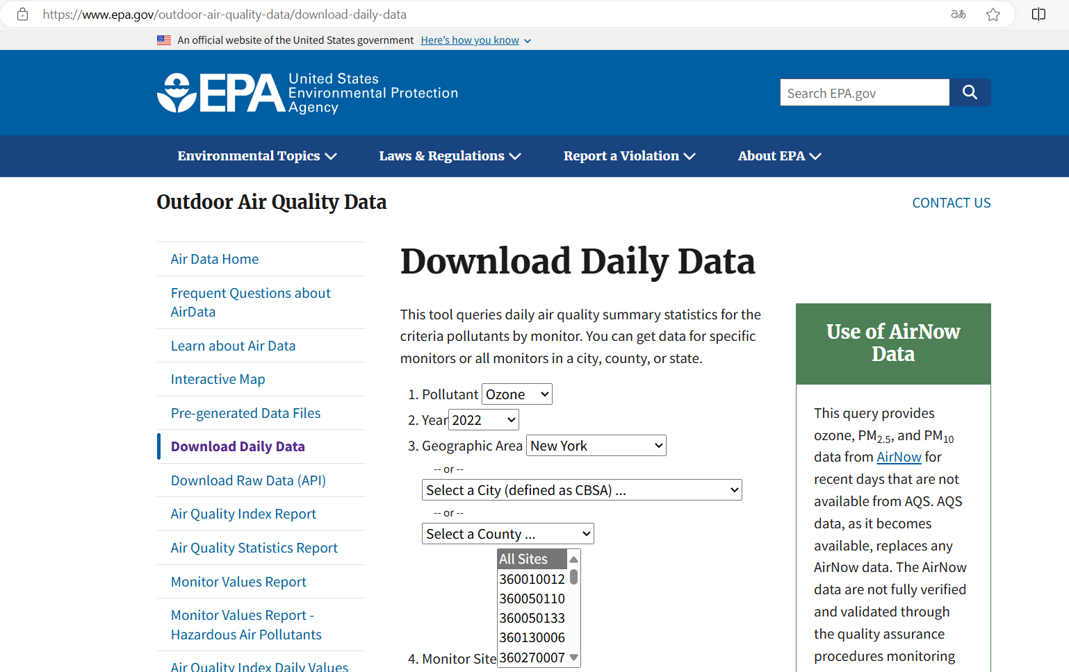
REQUIREMENT PHASE:DATA RESEARCHING & GATHERING
Data source: Download Daily Data | US EPA
Our goal is to analyze New York air quality dataset spanning from 2019 to 2024, encompassing 18 different datasets focused on 3 specific pollutants over 6 years. This analysis will allow us to identify patterns and trends both before and after the pandemic, as well as project future trends. The insights gained will be instrumental in informing policy development for government agencies

Slide 7
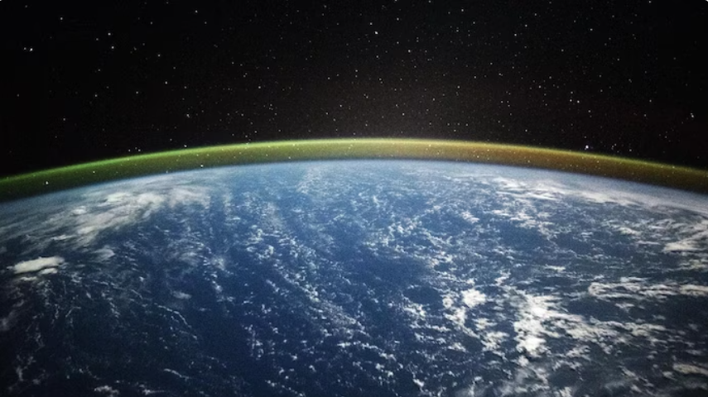
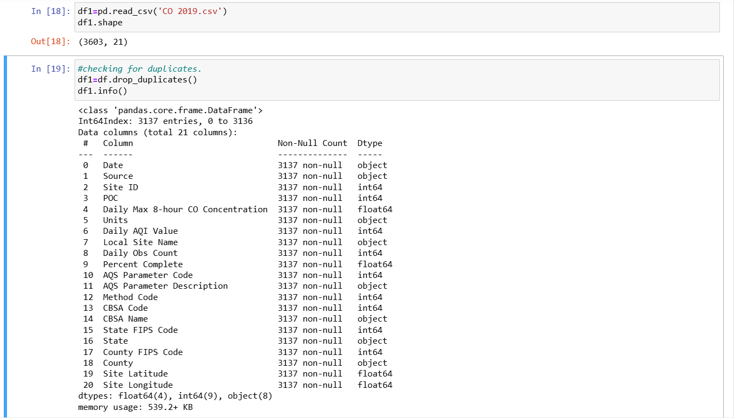
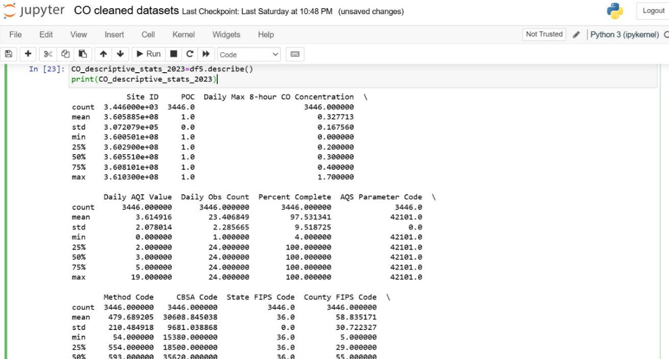
DESIGN PHASE:DATA CLEANING
Dropping duplicated records
Cleaning CO dataset

Slide 8
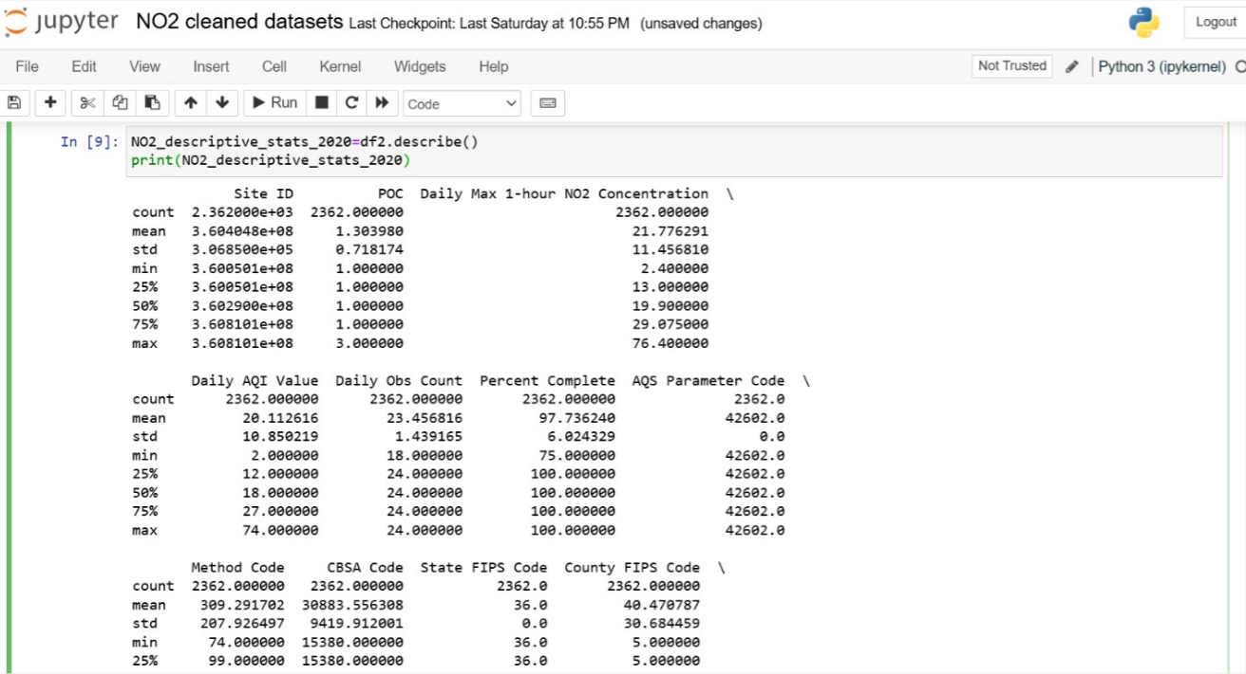
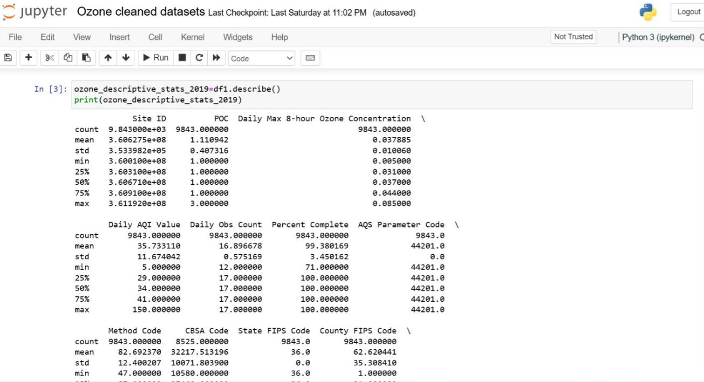
DESIGN PHASE:DATA CLEANING
Cleaning NO2 dataset
Cleaning Ozone dataset

Slide 9

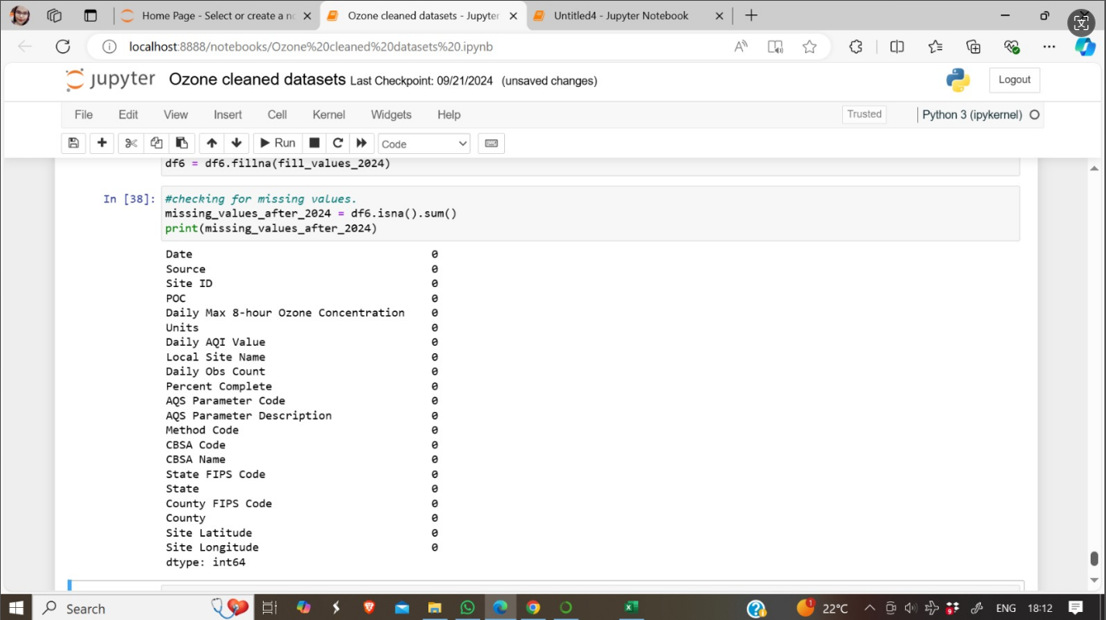
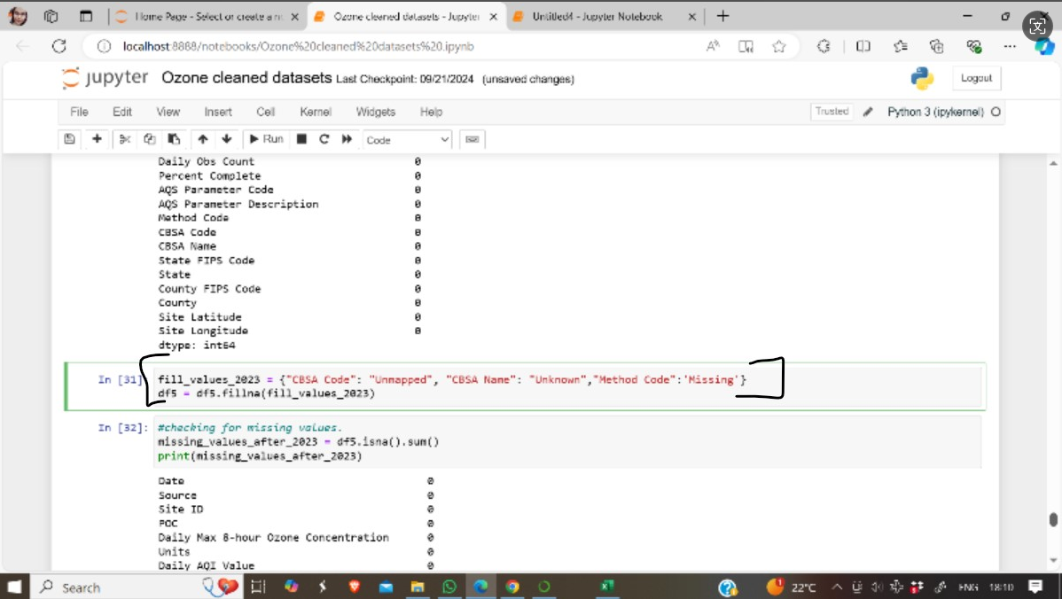
DESIGN PHASE:DATA CLEANING
Handle missing values

Slide 10
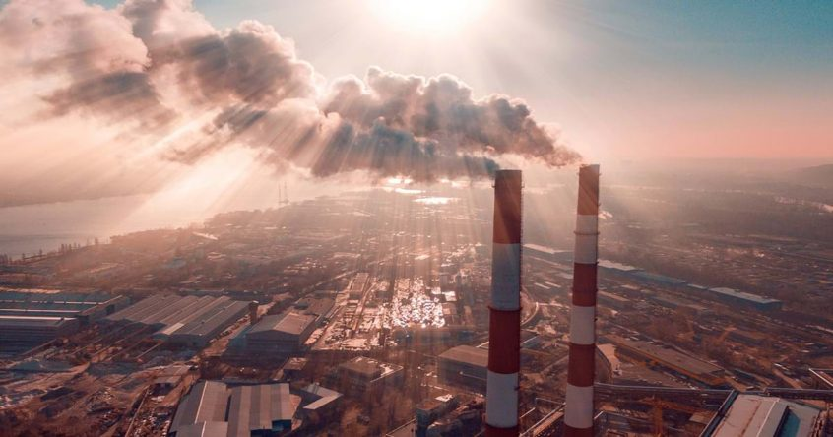
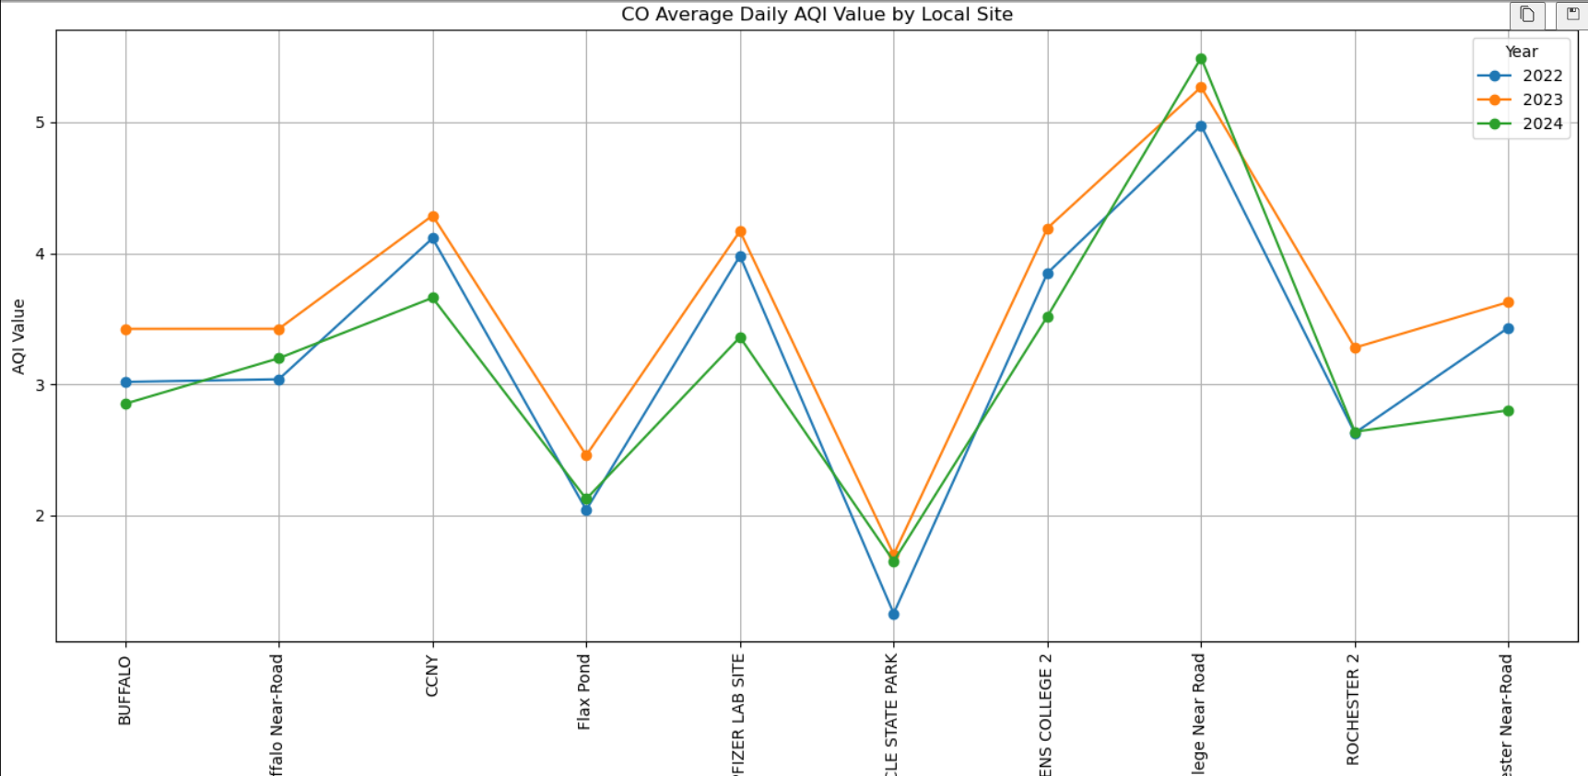
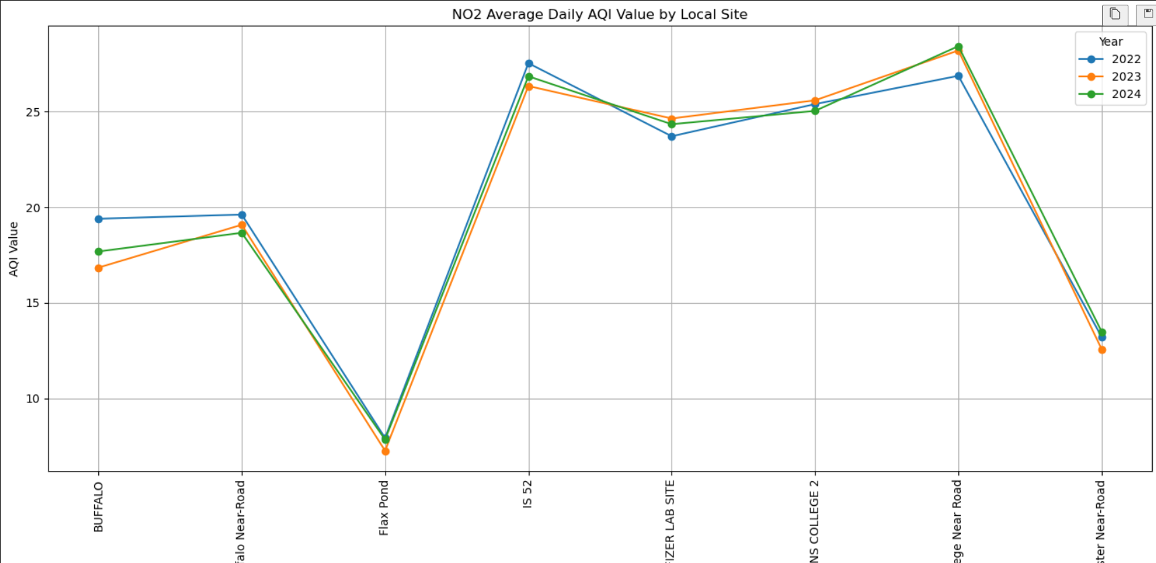
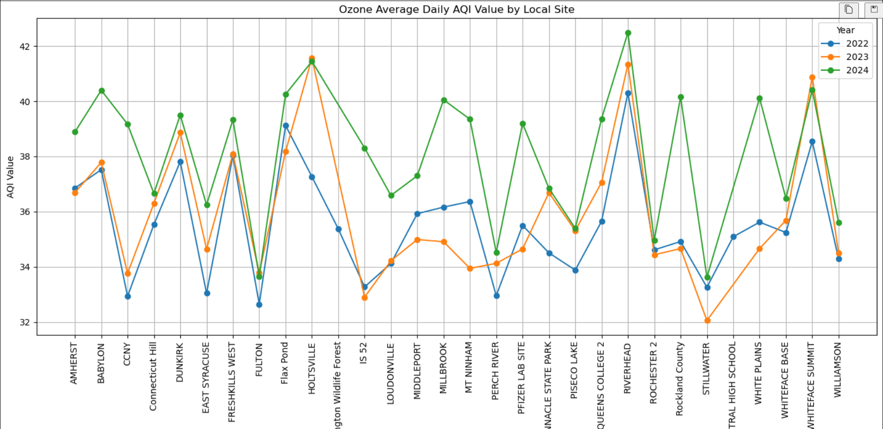
DEVELOPMENT PHASE: EDA PROCESS
Insights Gained:
1, TOP 3 sites by pollutant;
2, Queens college & near road stood out

Slide 11
How trends changed during Covid-19 Pandemic?
Generally, there was a decrease in CO concentration across most sites in 2021 compared to 2019 and 2020.
Notable Exceptions:
Buffalo: While the CO concentration in Buffalo remained relatively stable in 2020 compared to 2019, it experienced a significant increase in 2021.
Queens College 2: Similar to Buffalo, Queens College 2 saw a rise in CO concentration in 2021 after experiencing a slight decrease in 2020.
The CO concentration at each site fluctuated significantly during the three years, indicating a potential influence of various factors beyond COVID-19, such as weather patterns, seasonal changes, and industrial activity.
NO2 concentration at most sites decreased during 2020, possibly due to reduced traffic and industrial activity during the pandemic.
Generally, the ozone concentrations in 2020 and 2021 were lower than in 2019 for most of the locations. However, there were some locations where the ozone concentration increased in 2020 or 2021 compared to 2019.

Slide 12
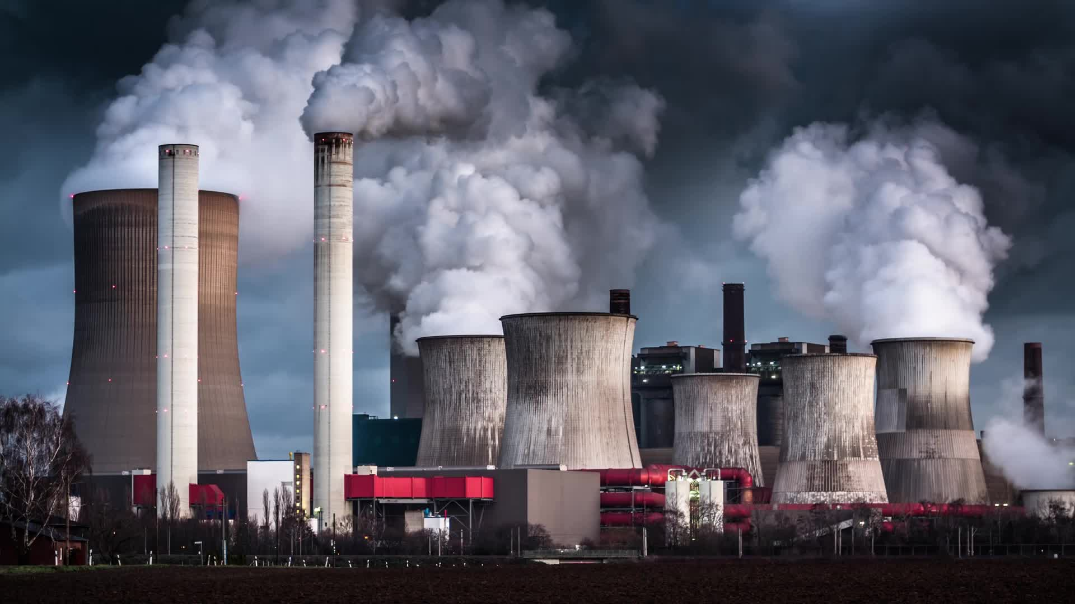
How trends evolved after Covid-19 ?
The trends for CO suggest a shift from the decrease observed in 2021 to an increase in the following years. Possible reasons for the increase in CO levels include increased vehicle emissions, industrial activity, seasonal changes, urbanization etc.
NO2 concentrations show a decreasing trend across all sites from 2022 to 2024.
Ozone concentrations show site-specific variations, with some showing higher levels in 2024, while others show higher levels in 2022 or 2023.

Slide 13
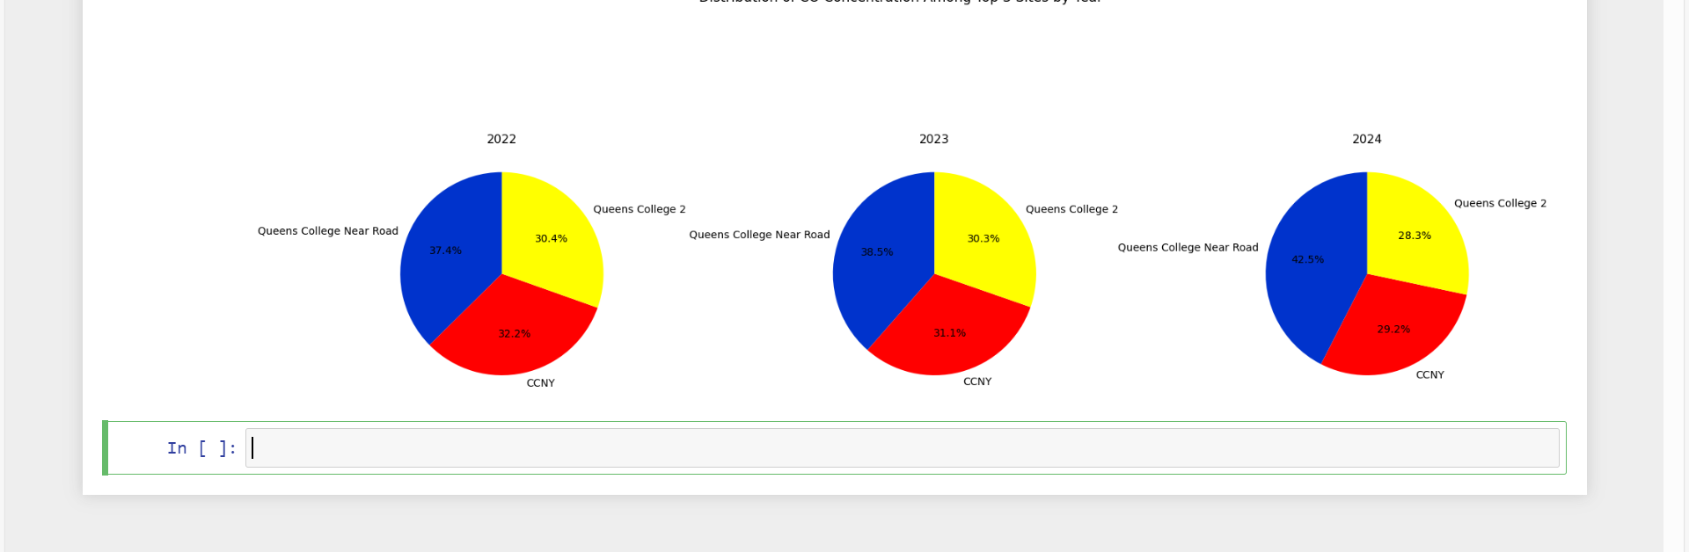
TOP 3 SITES HAVING HIGHEST CO CONCENTRATIONS(2022-24) : Queens college near road - CCNY - Queens college 2

Slide 14
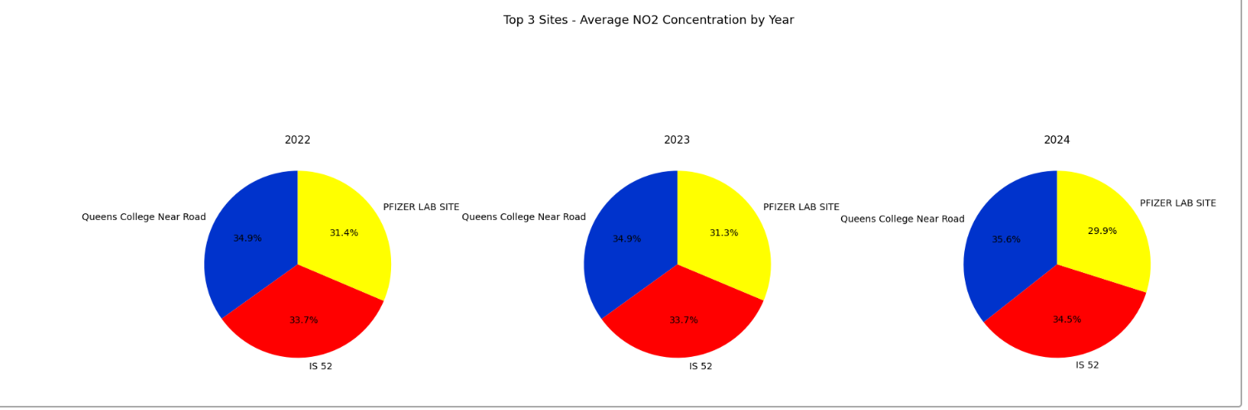
TOP 3 SITES HAVING HIGHEST NO2 CONCENTRATIONS(2022-24):
-Queens college near road - IS 52 - Queens college 2

Slide 15
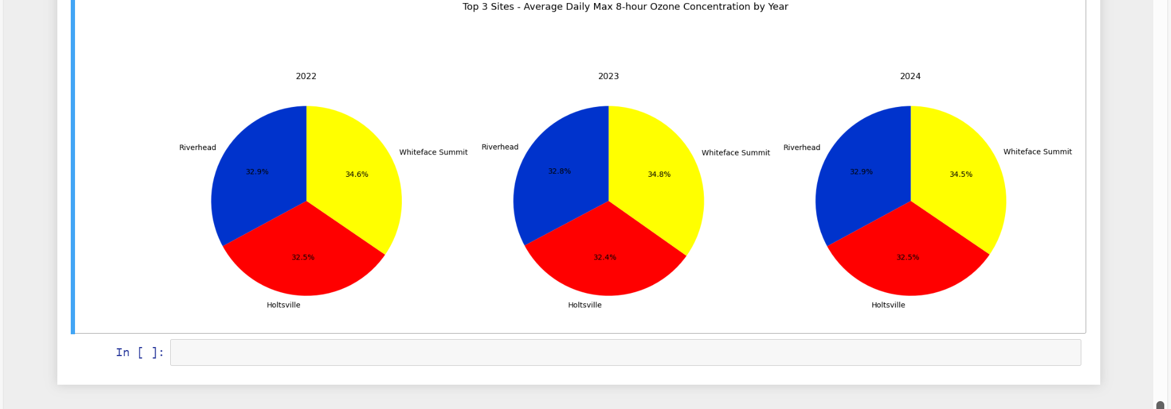
TOP 3 SITES HAVING HIGHEST OZONE CONCENTRATIONS(2022-24) :
- River head - Holtsville - Whiteface summit Notes: Queens college 2 might’ve not made to the top 3 list, but still at a high level, also had a steady growth over the years

Slide 16
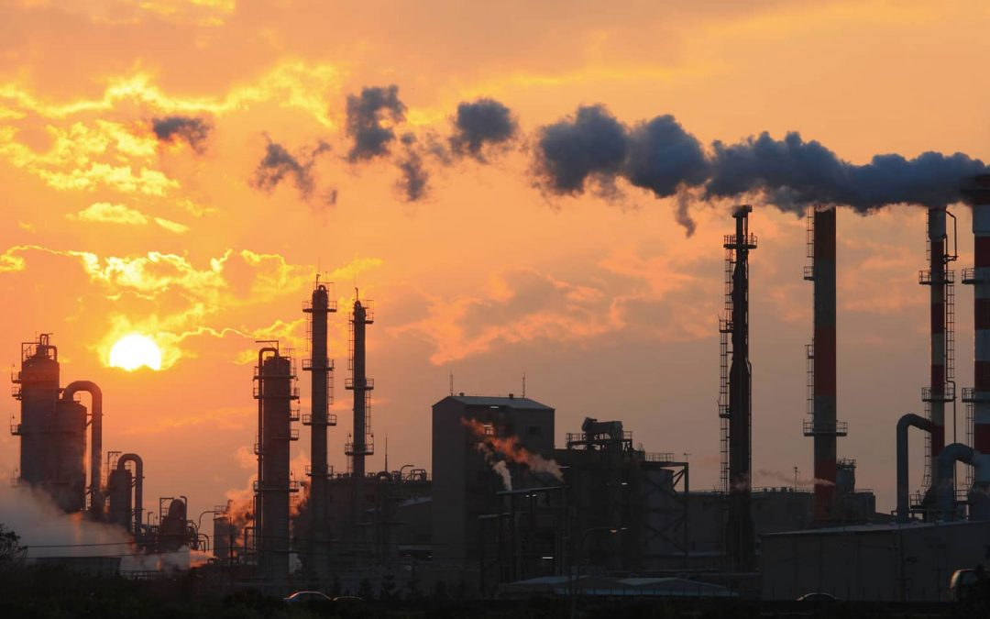
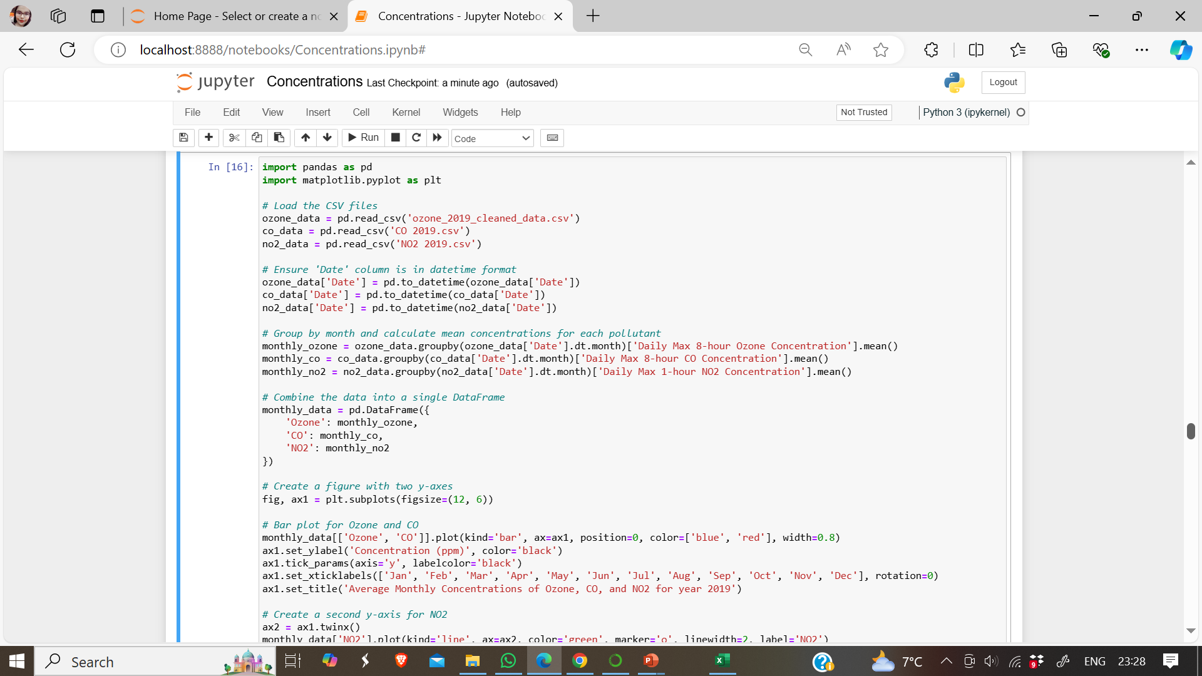
DEVELOPMENT PHASE: TIME SERIES ANALYSIS
Time series analysis by month

Slide 17
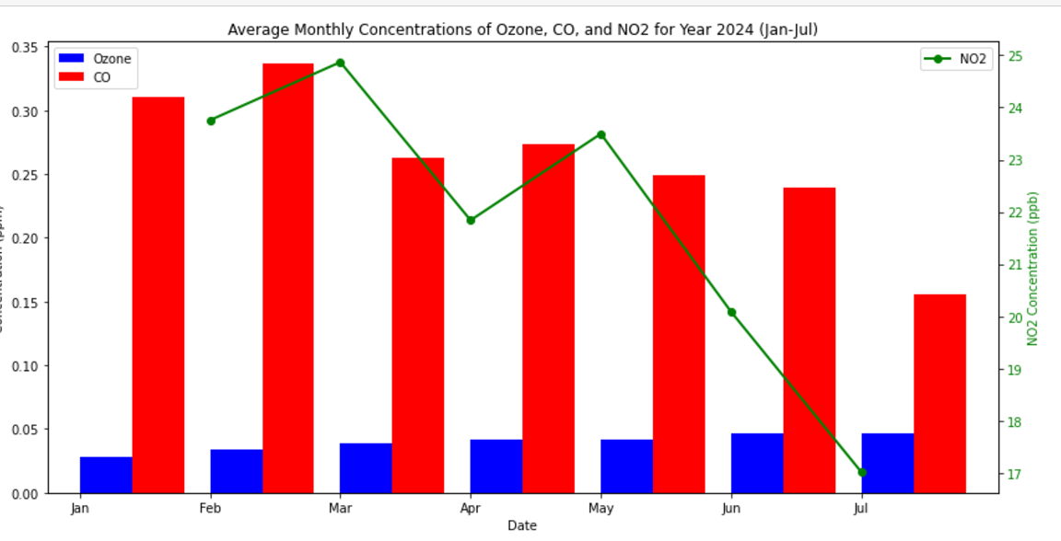
CURRENT TRENDS- 2024
The trends suggest that the air quality in the observed region is generally good, with ozone concentrations staying relatively stable throughout the year. The significant decline in NO2 levels throughout the year might indicate successful implementation of measures aimed at reducing nitrogen dioxide emissions. It's important to note that the CO concentration is still relatively high, particularly in January and february, highlighting the need for further efforts to address carbon monoxide pollution.

Slide 18
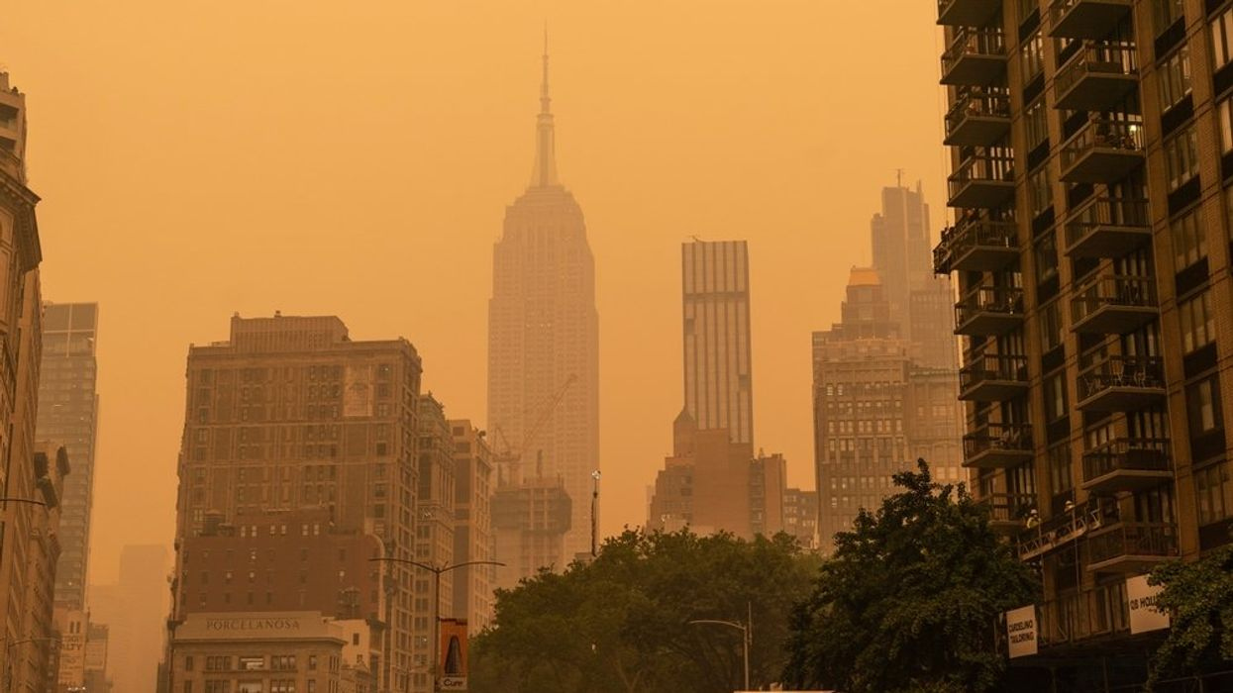
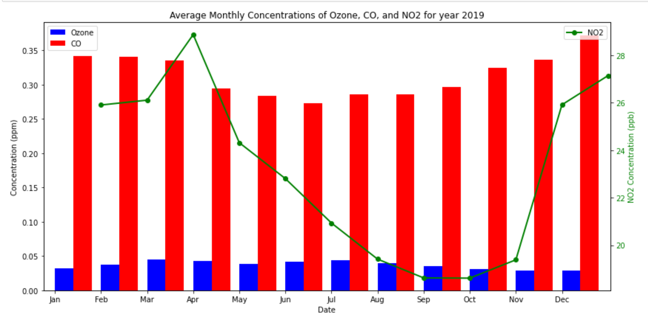
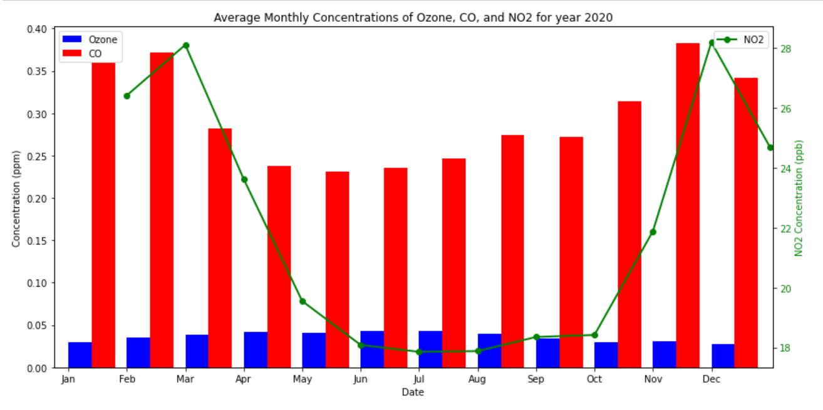
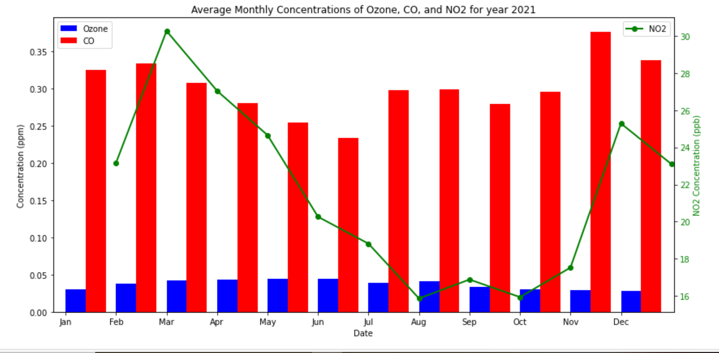
DEVELOPMENT PHASE:TIME SERIES ANALYSIS
Time series analysis for each pollutant by month
For the time span (2019 - 2021)
RED = CO
Blue = Ozone
Green = NO2

Slide 19
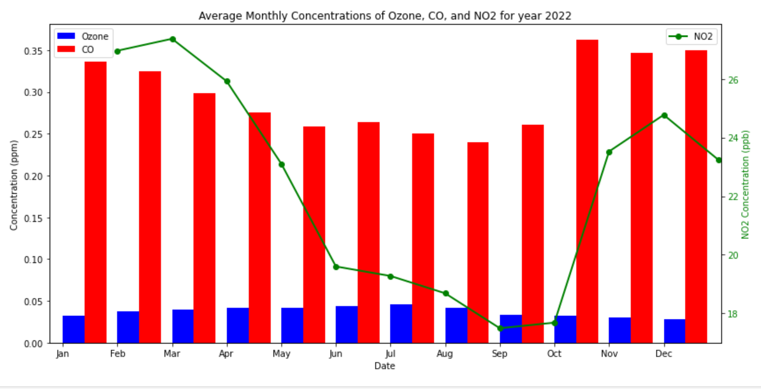
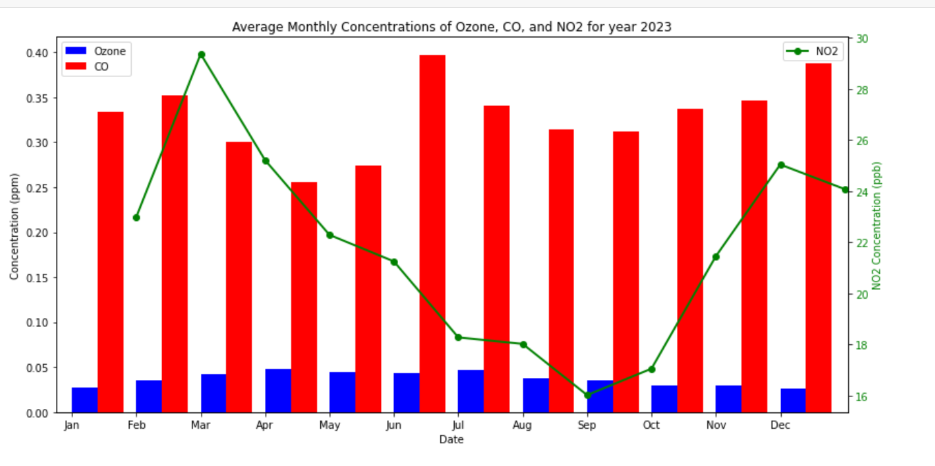
DEVELOPMENT PHASE:EDA PROCESS - 2

Slide 20
DEVELOPMENT PHASE
Insights gained from time series analysis
In 2019, The concentrations of all three pollutants are generally higher in the winter months (December, January, February) and lower in the summer months (June, July, August).
This trend may be attributed to factors such as increased heating use in the winter, which leads to higher emissions, and lower levels of sunlight and atmospheric circulation in the winter, which can trap pollutants.
In 2020, Ozone and NO2 concentrations both peak in December and are lowest in June. CO concentration peaks in February and drops steadily throughout the year.
In 2021, The ozone average monthly ozone concentrations show a declining trend from January to July with a spike in March. Concentrations remain relatively low for the rest of the year.
CO: The average monthly CO concentrations remain relatively high throughout the year with a peak in February, followed by another peak in December. There are no significant dips observed in the trend.
NO2: The average monthly NO2 concentrations show a relatively steady increase from January to December with a peak in December.
In 2022, the chart highlights a seasonal variation in ozone concentrations, with higher levels in the latter part of the year. CO levels remain relatively constant, while NO2 concentration shows a steady increase over the year.
In 2023, chart suggests that all three pollutants, Ozone, CO, and NO2, exhibit a seasonal trend, with peak concentrations occurring in the early months of the year (February and March). The concentrations of Ozone and CO then declined throughout the year, while the concentration of NO2 continued to increase.
In general, The plot suggests that all three pollutants, Ozone, CO, and NO2, exhibit a seasonal trend, with peak concentrations occurring in the early months of the year (February and March). The concentrations of Ozone and CO then declined throughout the year, while the concentration of NO2 continued to increase

Slide 21
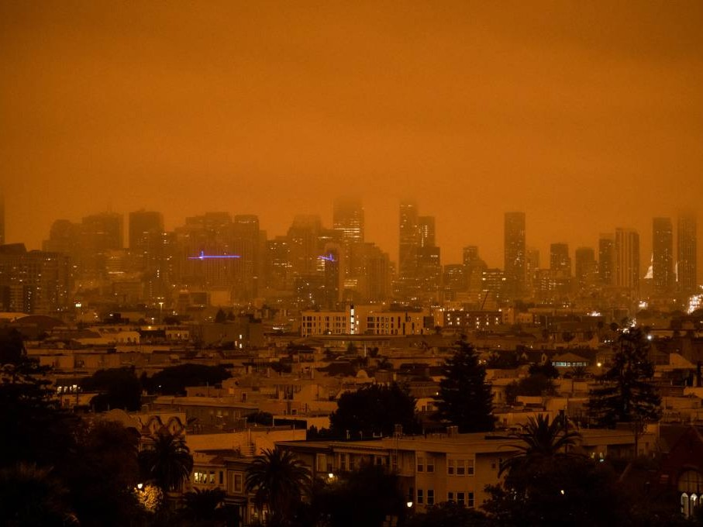
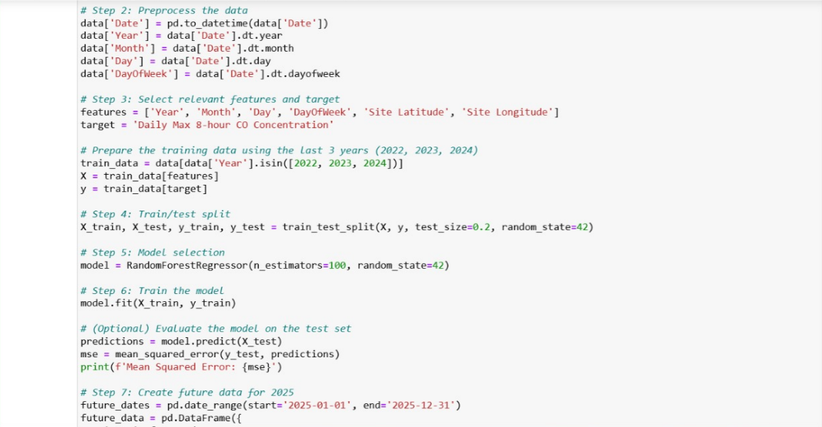
WEEK 8: RESEARCH ON TOP3S(2022-24)
REGRESSION MODEL FOR CO AND OZONE- RANDOM FOREST REGRESSSOR
It's important to note that the model's predictions are just that - predictions - and they may not perfectly reflect the actual concentrations that will be observed in 2025.

Slide 22
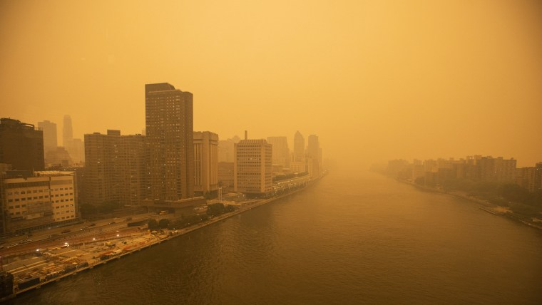
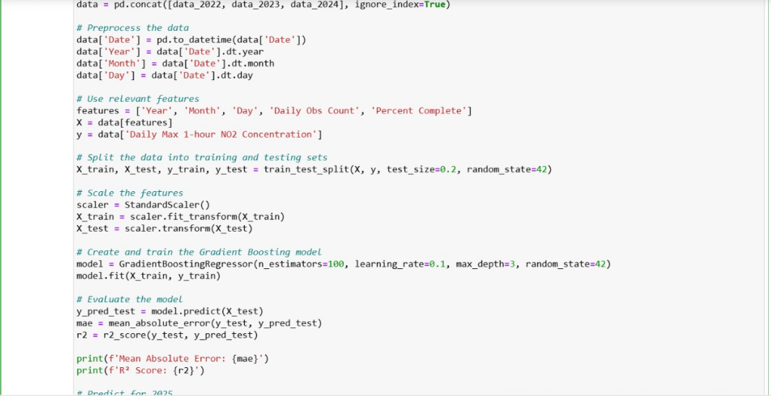
WEEK 8: RESEARCH ON TOP3S(2022-24)
REGRESSION MODEL FOR NO2 –GRADIENT BOOSTING REGRESSION
It's important to note that the model's predictions are just that - predictions - and they may not perfectly reflect the actual concentrations that will be observed in 2025.

Slide 23
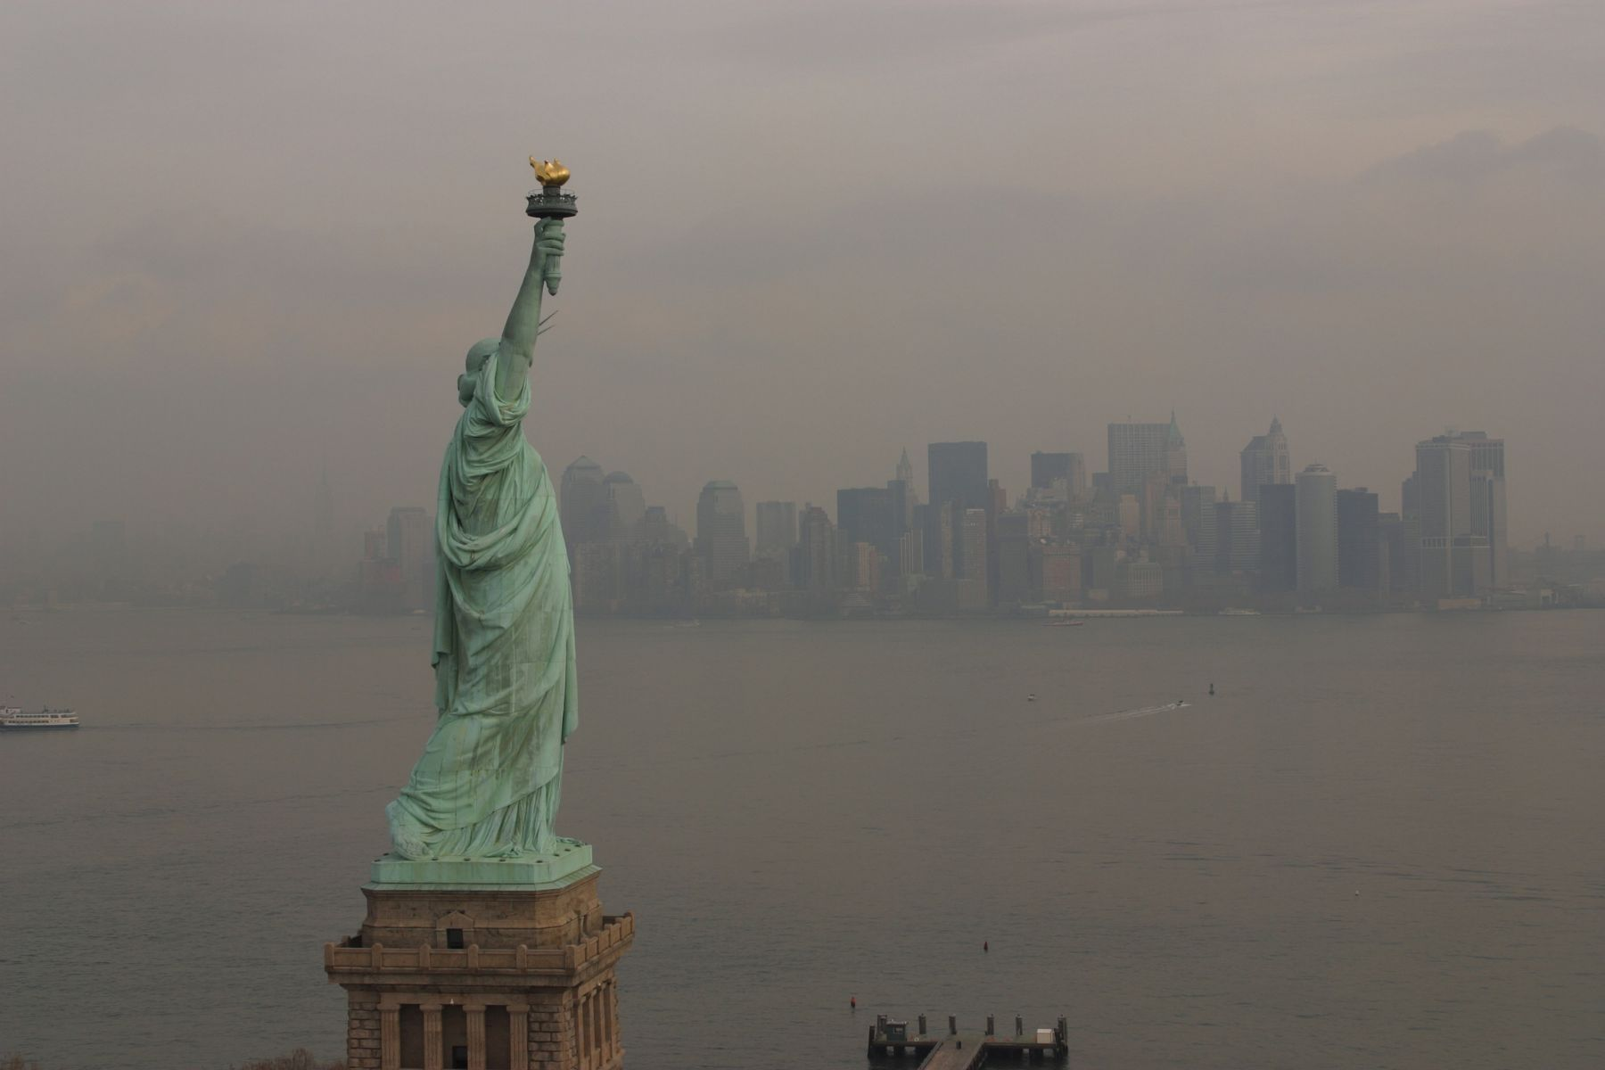
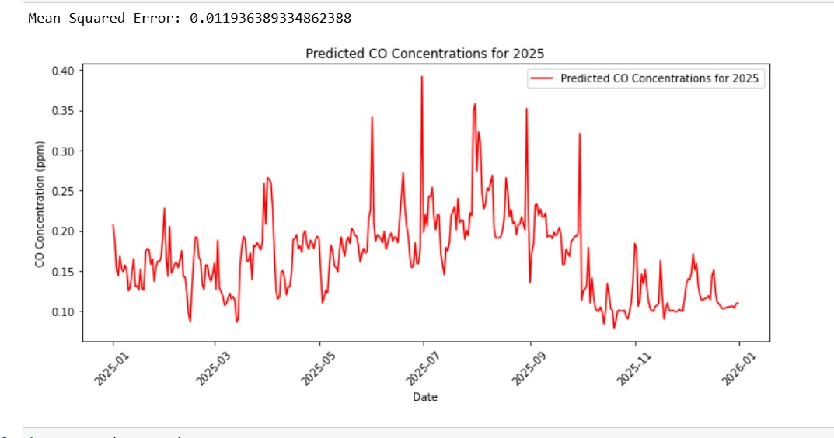
WEEK 8: RESEARCH ON TOP3S(2022-24)
TESTING PHASE:PREDICTIVE MODELING
The line on the graph shows that the predicted CO concentration is expected to fluctuate throughout the year, with peaks in the summer months and troughs in the winter months. The mean squared error is a measure of how well the model fits the data, and a lower MSE indicates a better fit. In this case, the MSE is 0.0119, which suggests that the model fits the data well.

Slide 24
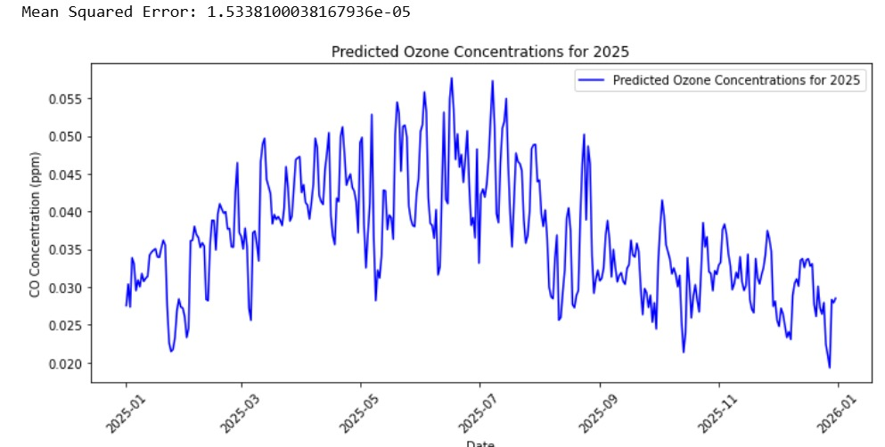
WEEK 8: RESEARCH ON TOP3S(2022-24)
TESTING PHASE:PREDICTIVE MODELING
The data points show a general downward trend throughout the year

Slide 25
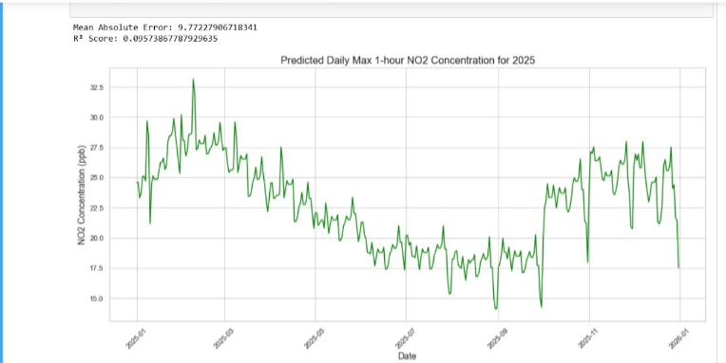
WEEK 8: RESEARCH ON TOP3S(2022-24)
TESTING PHASE:PREDICTIVE MODELING
The graph suggests a cyclical pattern of ozone concentration throughout the year, peaking during the summer months and dropping during the winter. This is likely due to factors like increased sunlight and warmer temperatures in the summer, which promote ozone formation. The exact timing and magnitude of these peaks and troughs may vary, depending on other factors like weather patterns, pollution levels, and regional variations.

Slide 26

· The model shows a cyclical pattern for predicted CO concentrations in 2025, with peaks and dips throughout the year. This suggests that the model has captured the seasonal variations in CO concentration, likely influenced by factors like weather patterns and human activity. The highest concentration occurs in the summer months, while the lowest is seen in the winter. · The model shows the predicted ozone concentrations for 2025. Based on the trend observed in previous years, it appears that the model predicts ozone concentrations to be highest during the spring and early summer months, and lowest during the fall and winter months. This is consistent with the historical trends observed in ozone levels, which tend to peak during the spring and summer months due to increased sunlight and warmer temperatures, which promote ozone formation. · The plot shows that NO2 concentration is predicted to be highest in the winter months and lowest in the summer months. This is consistent with the trends observed in 2022, 2023 and 2024.
INSIGHTS GAINED FROM THE MODELS

Slide 27

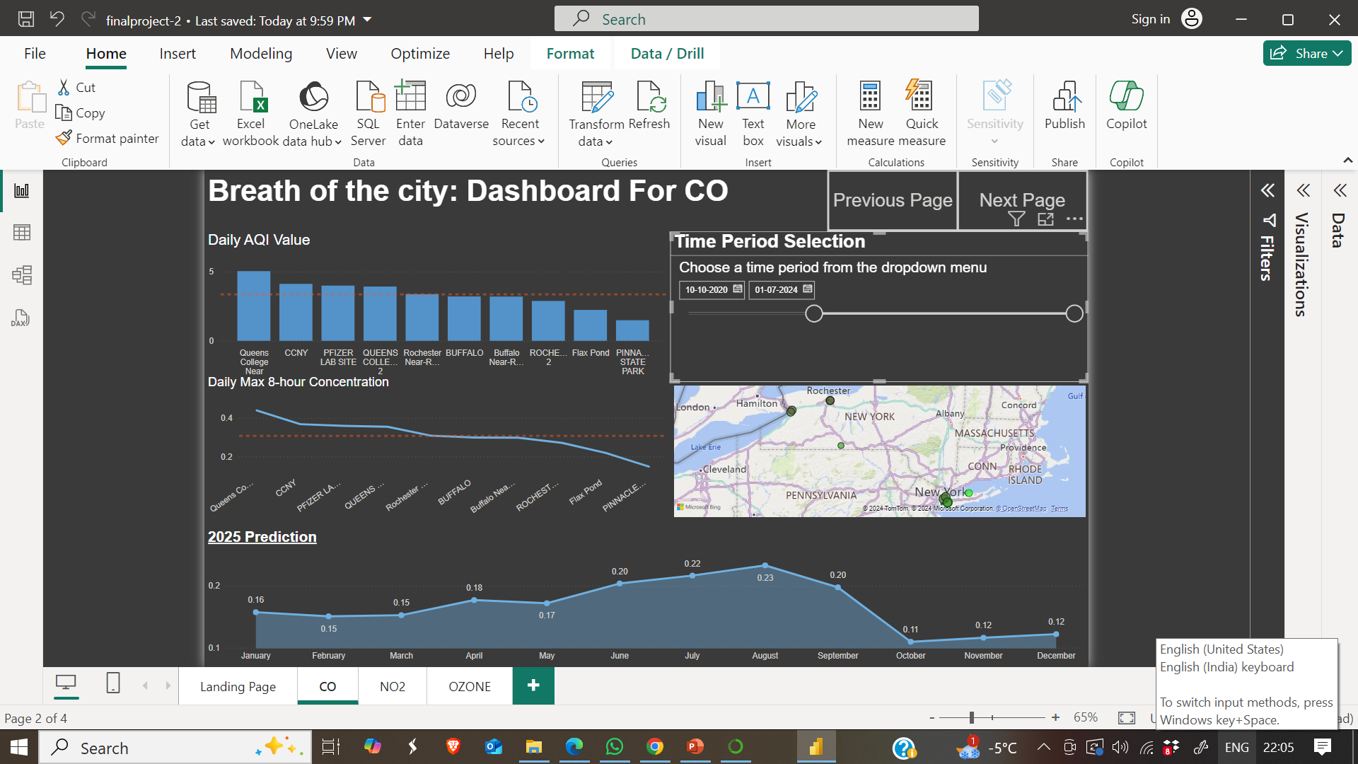
INTERACTIVE DASHBOARD -CO
The 2025 prediction graph shows a slight increase in CO levels from January to June, followed by a gradual decline through December. This suggests that CO levels are expected to be higher during the initial part of the year and then decrease towards the end. However, the overall trend indicates a relatively stable CO concentration in 2025.

Slide 28
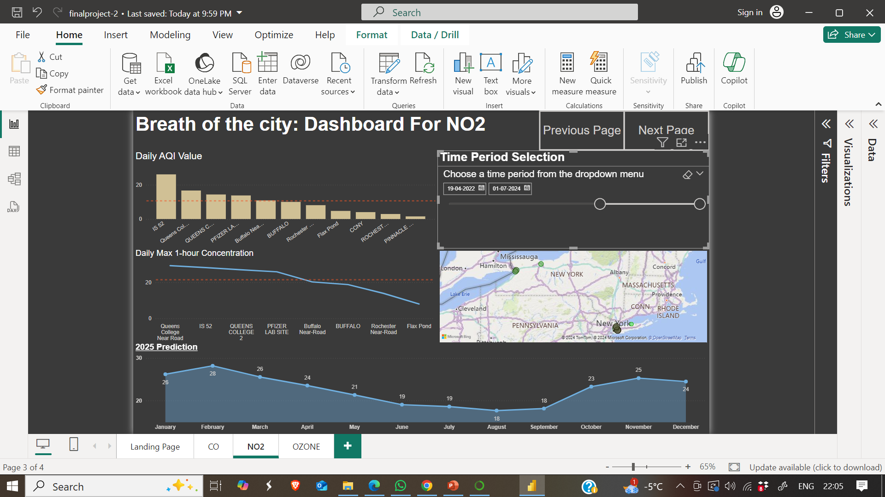
INTERACTIVE DASHBOARD –NO2
The trend for NO2 prediction is generally decreasing from the beginning of 2025 until the end of the year.

Slide 29
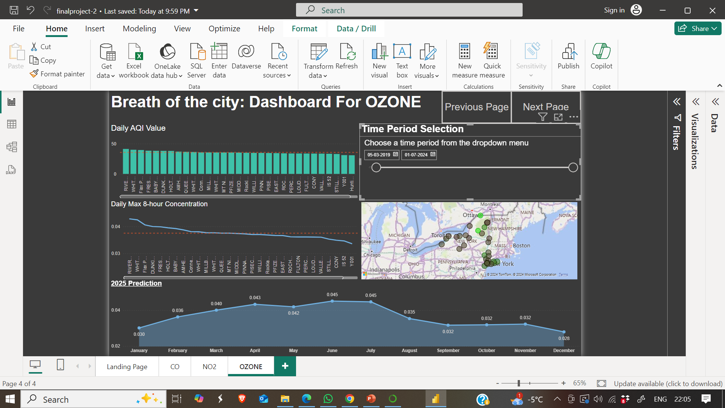
INTERACTIVE DASHBOARD -OZONE
The prediction for Ozone is a complex one, but it shows a slight increasing trend from January to October before slightly decreasing in November and December.

Slide 30
WHY POLLUTION LEVELS ARE GETTING HIGHER IN NEW YORK?
The largest source of carbon monoxide in urban areas like New York is the combustion of fossil fuels in cars, trucks, and buses. As per Federal Highway Administration , New York state has 10,903,620 registered vehicles. Also, Car and truck engines, especially diesel-powered ones, are major sources of nitrogen oxides (NOx), which include NO2.
Moreover, In winter months, heating systems that burn coal, wood, or oil contribute to CO and NO2 levels.
Industries that release VOCs, such as refineries, chemical manufacturing, and some solvent use, also contribute to ozone formation.
69% of the power generated in downstate New York comes from fossil fuel power plants. New York City has 19 power plants with 89 peaking units, and many of these units are over 50 years old.

Slide 31
WHAT MEASURES SHOULD BE FOLLOWED TO CONTROL POLLUTION LEVELS?
To effectively control pollution levels, especially those of harmful pollutants like carbon monoxide (CO), nitrogen dioxide (NO2), and ozone (O3), a combination of regulatory measures, technological solutions, public policies, and behavioral changes is necessary. Here are some of the key measures that can be taken:
Offer incentives for EVs, such as tax credits, rebates, and exemptions from certain fees. Establish EV charging infrastructure and support the transition from gasoline and diesel to electric power for public and private vehicles
Support the shift from fossil fuels to renewable energy sources such as wind, solar, and hydroelectric power. This reduces the emissions from power plants that contribute to NO2 and CO.
Provide financial incentives, rebates, and tax credits for businesses and homeowners to adopt clean technologies like energy-efficient appliances, electric vehicles, and solar panels.

Slide 32

THANK YOU QUESTIONS?

